Slide 1
CSE 205 Digital Logic Design Week 7
Dr. Mahmuda Naznin

Slide 2
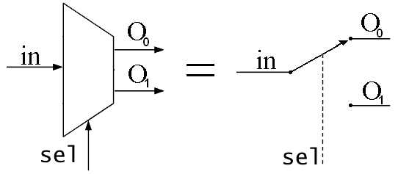
De-Multiplexer

Slide 3
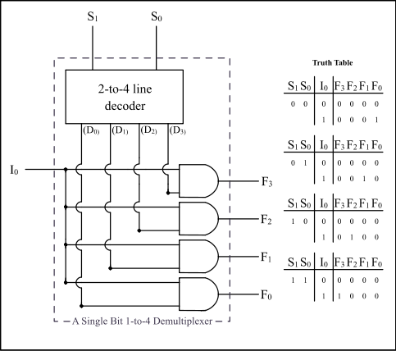
De-Multiplexer

Slide 4
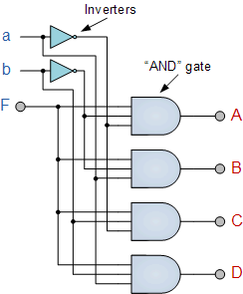
De-Multiplexer

